Slide 1
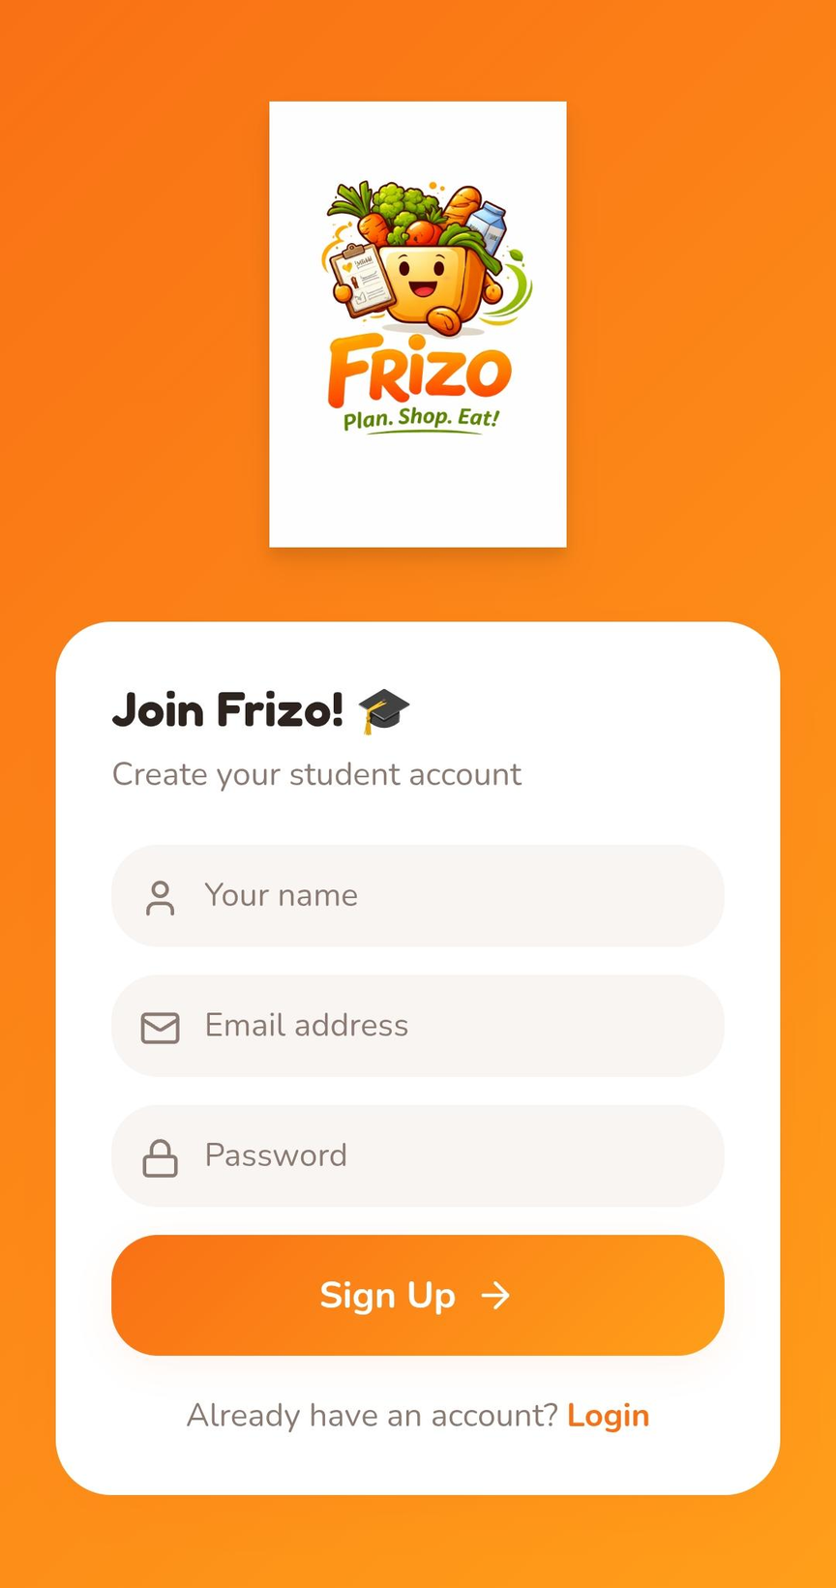

UI/UX
Frizo: Reimagining Grocery Delivery
A comprehensive UI/UX redesign proposal for Frizo, addressing critical pain points and positioning the app against Blinkit's current limitations
Pushpendra 241096
Yuvrajsinh 241148
Devdeepsinh 241153
Luckyrajsinh 241146
Sunil 241098
Namdev 241109

Slide 2
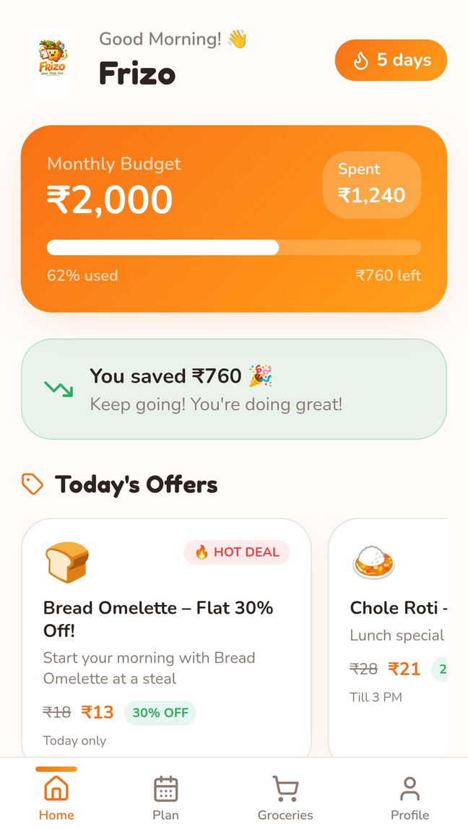
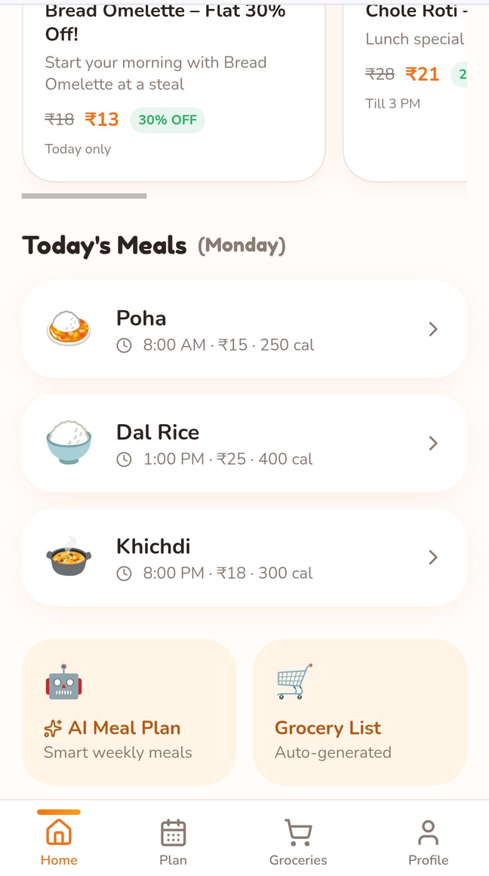
Why Frizo? Startup Selection & Market Context
Strategic Positioning
Frizo operates in the hyperlocal grocery delivery space, directly competing with Blinkit. Unlike Blinkit's 10-minute delivery focus, Frizo can differentiate through superior user experience and thoughtful design.
Market Opportunity
The Indian grocery delivery market is projected to reach $20 billion by 2025. With Blinkit's poor prototype quality and UX limitations, there's significant whitespace for a well-designed alternative.

Slide 3
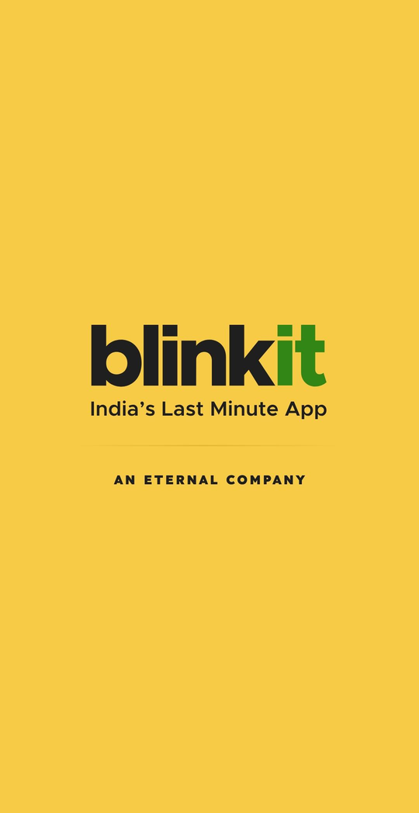


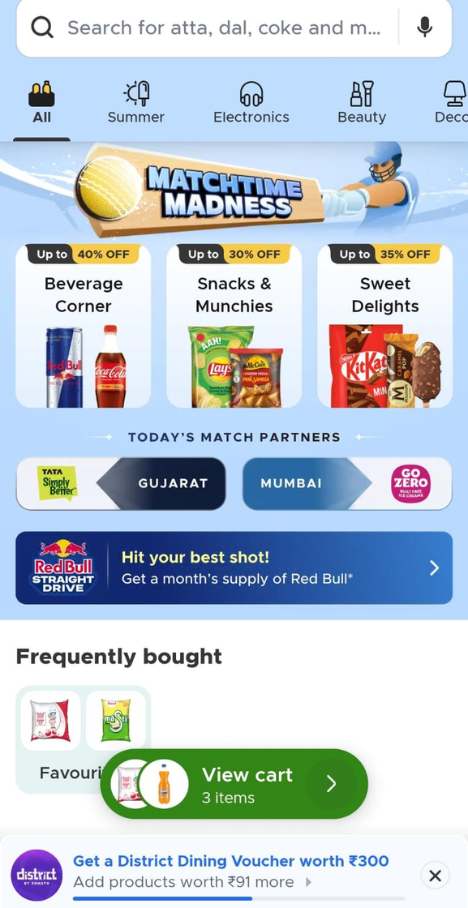

Competitive Analysis: Blinkit's Weaknesses
Poor Information Architecture
Prototype-Level Quality
Visual design lacks polish with inconsistent spacing, typography, and component styling
Users struggle to find products due to unclear categorization and navigation hierarchy
Performance Issues
Slow load times and unresponsive interactions create frustration during critical shopping moments

Slide 4
Critical UI/UX Problems Identified
Navigation Confusion
Visual Inconsistency
Checkout Friction
Hidden menu structures increase cognitive load
No clear visual hierarchy between primary and secondary actions
Users frequently miss key features and promotions
Mixed design patterns across different screens
Inconsistent button styles and color usage
Poor spacing and alignment reduce readability
Multi-step process with unclear progress indicators
Address management is cumbersome and error-prone
Payment options lack clear security signals

Slide 5


Design Revamp Strategy
Three-Phase Approach
Phase 1: Foundation - Establish design system, component library, and accessibility standards
Phase 2: Core Experience - Redesign search, navigation, and product discovery flows
Phase 3: Conversion - Optimize checkout, cart management, and payment experience

Slide 6
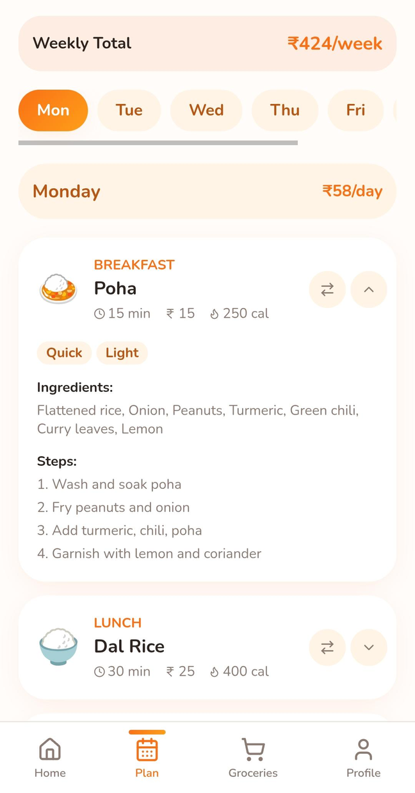

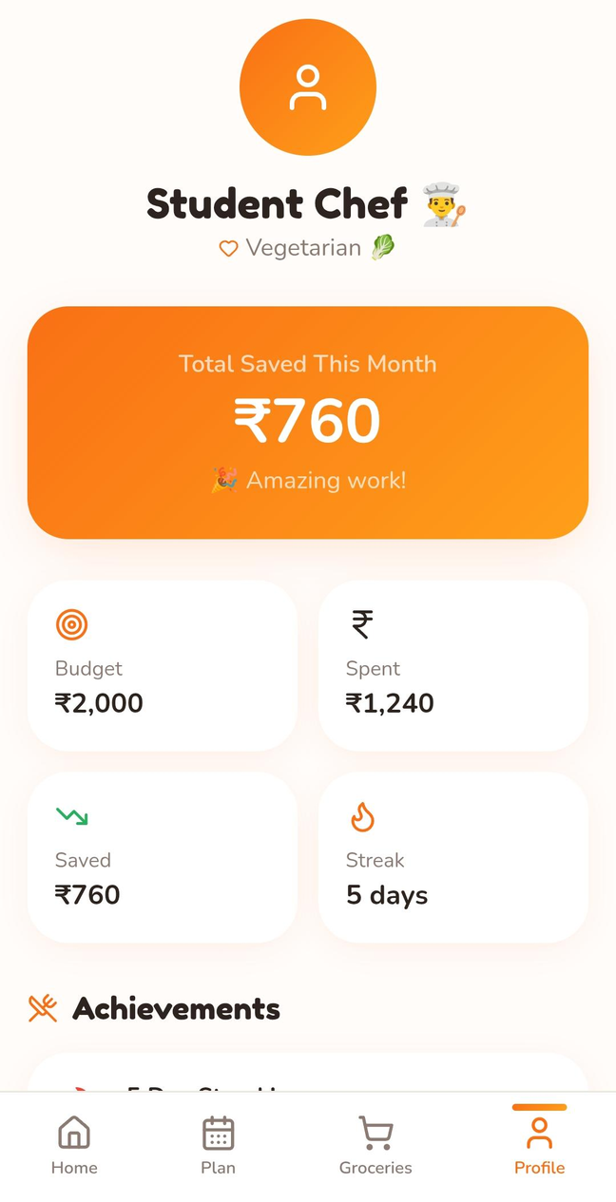


Wireframe Design Process
Low-Fidelity Sketches
Quick paper prototypes to validate flow logic and user mental models before investing in digital design
Mid-Fidelity Wireframes
Grayscale screen flows focusing on layout, hierarchy, and interaction patterns without visual distractions
High-Fidelity Mockups
Pixel-perfect designs with full color, typography, and interactive states ready for developer handoff

Slide 7
Key Improvements & Expected Impact
45%
30%
Reduced Navigation Time
Lower Abandonment Rate
Users find products faster with improved IA and persistent navigation
Simplified checkout flow reduces cart abandonment at critical steps
25%
4.5
Increased Conversion
Higher Satisfaction Score
Clear CTAs and visual hierarchy drive more completed purchases
Polished design and smooth interactions boost overall user satisfaction

Slide 8


Mockup Showcase: Before & After
Home Screen Evolution
Product Discovery
From cluttered promotional banners to clean category grid with personalized recommendations and quick-search bar
Transformed from text-heavy lists to visual cards with clear pricing, ratings, and add-to-cart actions
Before
After

Slide 9




Next Steps: From Design to Delivery
User Testing
Development Handoff
Phased Launch
Conduct usability tests with 15-20 target users to validate design decisions and identify remaining pain points
Provide detailed specifications, design assets, and interactive prototypes for engineering implementation
Roll out redesign in phases, monitoring analytics and user feedback to iterate on the experience
Budget & Timeline: Complete redesign in 8-10 weeks with $15,000-$25,000 investment depending on scope and testing requirements

Slide 10


